Slide 1

React.js Fundamentals
Course Overview, Trainers, Evaluation
SoftUni Team
Technical Trainers
Software University
https://softuni.bg/

Slide 2

Table of Contents
Course Overview
Course Objectives
Course Topics
Trainers Team
Exams and Evaluation
Learning Resources

Slide 3
Have a Question?
sli.do
#js-web

Slide 4

React.js Fundamentals
Course Objectives & Program

Slide 5

Course Objectives
The React.js Fundamentals course provides
Fundamental understanding of JSX and React
Covers component-based architecture
Establishes Immutable UI concepts
What is NOT covered?
JavaScript basics and REST communication
Optimization and Web Components

Slide 6
Warning: Not for Absolute Beginners
The "React.js" course is NOT for absolute beginners
Requirements
HTML & JS (ES 2016) coding skills – intermediate level
If you want you can take the HTML & CSS Mini Course at SoftUni first:
HTML & CSS
Computer English – entry level

Slide 7

Course Topics
React.js overview, JSX syntax
Components, state, lifecycle
Events, forms, composition
Routing and Architecture
Higher-Order Components (HOC)
Workshop

Slide 8

The Team

Slide 9
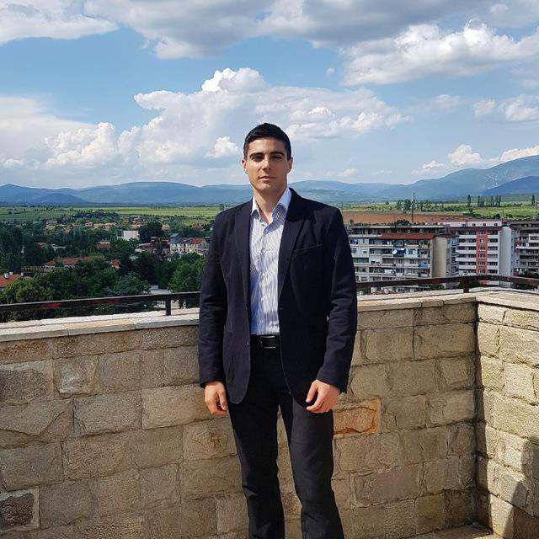
William Abboud
Full Stack & Senior Front-End Developer @ SoftUni
Studied Computer Science in Newcastle University
Passionate about Front-End Technologies (HTML/CSS/JS/React.js) and UX/UI Design

Slide 10
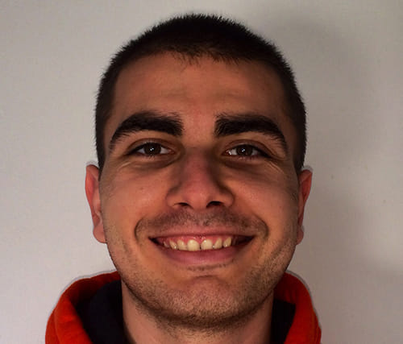
Ivan Shulev
Bachelor in Web Development
Former Front-end Tech Lead @ Melon
Experience with React.js, Angular, Vue.js PHP, MySQL

Slide 11

Course Organization

Slide 12

Training Duration
Lessons: ~30 hours (onsite + videos)
Practical exercises (in class): ~30 hours
Project Defense: 15 minutes
Defense date: 17 March 2019
Retake defense date: 23 April 2019

Slide 13

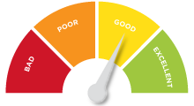
Scoring System for the Course
Project – 90%
Homework (exercises) – 10%
Bonuses: up to 10%
Presence in class: 5% (onsite students only)
Forum activities: 5%

Slide 14



Learn to Search Online
The course assignments require searching online
This is an important part of the learning process
Some exercises intentionally have no hints
Learn to find solutions!
Software development includes everyday searching and learning
No excuses, just learn to study!
Developers learn new technologies, tools, languages every day!

Slide 15

Homework Assignments
Doing your homework is very important!
Programming can only be learned through a lot of practice!
You should write code every day!
Each lesson is followed by many exercises
Try to solve them in class
The rest are your homework
Homework assignments are due 7 days after each lecture
Submission through the course page

Slide 16
https://softuni.bg/opencourses/reactjs-fundamentals

Slide 17













SoftUni Diamond Partners

Slide 18




SoftUni Organizational Partners

Slide 19




Trainings @ Software University (SoftUni)
Software University – High-Quality Education and Employment Opportunities
softuni.bg
Software University Foundation
http://softuni.foundation/
Software University @ Facebook
facebook.com/SoftwareUniversity
Software University Forums
forum.softuni.bg

Slide 20

License
This course (slides, examples, demos, videos, homework, etc.) is licensed under the "Creative Commons Attribution-NonCommercial-ShareAlike 4.0 International" license

